Slide 1
PhishAlert AI (AI/ML Phishing Domain Detection)
Abhishek Hiremath (457CS21001)
Aditya Walvekar (457CS21005)
Muzammil Sandarwale (457CS21017)

Slide 2

AI/ML Phishing Domain Detection
This project report outlines the development of an innovative AI and Machine Learning-based tool aimed at detecting and mitigating the growing threat of phishing domains. Phishing attacks, which trick users into revealing sensitive information, pose a significant risk to individuals and organizations alike, leading to financial losses and data breaches. By leveraging advanced analytics and pattern recognition capabilities, this project aims to create a robust and efficient solution that can reliably distinguish between legitimate and fraudulent web domains in real-time, serving as a crucial enhancement to existing cybersecurity measures.

Slide 3

Project Introduction
The “AIML Tool for Phishing Domain Detection” project addresses the urgent need for robust cybersecurity measures in the face of growing phishing threats.
Phishing involves tricking users into revealing sensitive information through fake websites.
Traditional detection methods often struggle to keep up with the evolution of these threats.
That's why we used artificial intelligence and machine learning to develop an intelligent engine that can quickly and accurately detect phishing attempts in real time.
By leveraging cutting-edge technology, we aim to improve online security, protect user privacy, and reduce the risk posed by fraudulent activities.

Slide 4
Motivation & Need
In today's digital landscape, the rise in online transactions and interactions has led to an alarming increase in phishing attacks. These scams pose a significant threat to individuals and organizations alike, with cybercriminals using increasingly sophisticated techniques to deceive unsuspecting victims. Traditional security measures, such as firewalls and antivirus software, are struggling to keep pace with the evolving tactics employed by attackers. As a result, there is a critical need for innovative cybersecurity solutions capable of effectively detecting and mitigating phishing threats in real-time. Our project seeks to address this urgent need by developing a cutting-edge tool equipped with advanced algorithms to swiftly identify and neutralize phishing attempts, safeguarding users against potential harm and financial loss.

Slide 5
The Limitations of Traditional Cybersecurity Measures
Firewalls and Antivirus Software
Lack of Real-Time Threat Detection
Insufficient User Awareness
While traditional security measures like firewalls and antivirus software can provide a basic level of protection, they are often ineffective against the latest phishing techniques, which can bypass these defenses and exploit human vulnerabilities.
Many existing security solutions rely on outdated threat databases and struggle to keep pace with the rapidly evolving phishing landscape, leaving organizations vulnerable to new and emerging threats.
Even with security tools in place, end-users often remain susceptible to phishing attacks due to a lack of comprehensive security awareness training, making them the weakest link in the cybersecurity chain.

Slide 6
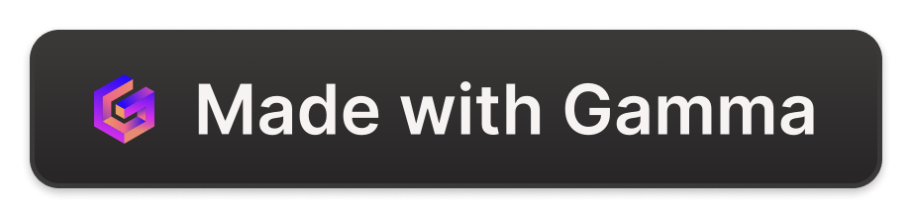
Project Aims and Objectives
Detect and Prevent Phishing Attacks
Implement Cutting-Edge AIML Techniques
Real-Time Phishing Detection & Insightful Remediation
The primary objective of this project is to develop an AI/ML-powered tool capable of accurately identifying and mitigating phishing domains in real-time. By leveraging advanced algorithms and data-driven insights, the tool aims to enhance cybersecurity measures and protect users' sensitive information from the dangers of fraudulent activities.
The project team will utilize state-of-the-art AIML algorithms to analyze and detect patterns associated with phishing domains. Through extensive training on diverse datasets, the tool will be equipped with the ability to distinguish between legitimate and malicious websites, minimizing false positives and providing reliable results.
We're creating a tool to spot phishing by checking links and content for signs of fraud. It'll monitor links in real-time and have a user-friendly interface. Using machine learning, it'll classify URLs as phishing or legitimate and provide insights for quick action. We'll keep improving it for better accuracy.

Slide 7
Intuitive User Interface
Insights and Response
Streamlined Interaction
The tool will feature a meticulously designed user interface that prioritizes simplicity and efficiency, ensuring cybersecurity professionals can navigate and interact with the system effortlessly.
Comprehensive Insights
The interface will provide a centralized hub where users can access detailed information about detected phishing threats, including risk assessments, mitigation recommendations, and historical trends.
Customizable Workflows
The tool will offer a high degree of customization, allowing users to tailor the interface and workflows to their specific needs, further enhancing the user experience and productivity.
Threat Visualization
The tool will present detected phishing threats in a clear and intuitive manner, utilizing data visualizations and interactive dashboards to help cybersecurity teams quickly identify patterns, trends, and high-risk areas.
Incident Response
Upon the detection of a phishing threat, the tool will provide immediate guidance and recommended actions, empowering cybersecurity teams to respond swiftly and effectively to mitigate the impact and prevent further damage.
Remediation Strategies
The tool will offer comprehensive remediation strategies, including the ability to block detected phishing URLs, notify affected users, and implement proactive measures to strengthen the organization's cybersecurity posture.

Slide 8




Key Technologies and Methodologies
Python
Flask
NumPy
BeautifulSoup
The project leverages Python as the primary programming language, providing a robust and versatile platform for developing the AIML-based phishing detection tool.
The Flask web framework is utilized to build the interactive user interface and backend components of the tool, enabling seamless integration with the AIML models.
The NumPy library is employed for efficient data manipulation and scientific computing tasks, which are critical for feature extraction and model development.
BeautifulSoup, a Python library for web scraping, is utilized to parse and extract relevant information from webpage content, contributing to the feature engineering process.

Slide 9
Key Technologies and Methodologies
Streamlit
NLTK
Scikit-learn
NumPy
Streamlit is a great tool for making user-friendly web apps. It helps you build easy-to-use interfaces for spam detection. You can add text boxes, buttons, and result displays, so users can interact with your spam classifier effortlessly.
It helps a lot with spam detection. It takes messy emails and cleans them up by chopping them into words, getting rid of unimportant words, and simplifying words. This makes them ready for the computer to understand.
Scikit-learn is a top choice for machine learning in Python. It's full of tools for sorting data and making predictions. For spam detection, it's great because it can set up workflows that handle getting data ready and training models automatically. This makes catching spam faster and easier.
NumPy is like the math wizard of Python. It's all about numbers and arrays. For spam detection, NumPy helps with calculations and organizing data, making everything run smoothly behind the scenes.

Slide 10
Development Methodologies
01
02
03
04
Agile Practices:
Foster flexibility and adaptability.
Enable iterative development and collaboration.
Ensure alignment with evolving requirements.
Phased Development Process:
Data Collection: Gather diverse, high-quality datasets.
Preprocessing: Clean, normalize, and extract features.
Model Development: Utilize machine learning algorithms.
Testing and Validation: Assess performance rigorously.
Deployment: Integrate with existing infrastructure.
Feedback Loops and Testing Cycles:
Gather input from stakeholders and end-users.
Validate model outputs iteratively.
Continuous Integration and Delivery (CI/CD):
Automate build, testing, and deployment processes.
Ensure rapid delivery of improvements.
Maintain integrity and reliability.

Slide 11
Development Methodologies
01
02
03
04
Agile Practices:
Foster flexibility and adaptability.
Enable iterative development and collaboration.
Ensure alignment with evolving requirements.
Phased Development Process:
Data Collection: Gather diverse, high-quality datasets.
Preprocessing: Clean, normalize, and extract features.
Model Development: Utilize machine learning algorithms.
Testing and Validation: Assess performance rigorously.
Deployment: Integrate with existing infrastructure.
Feedback Loops and Testing Cycles:
Gather input from stakeholders and end-users.
Validate model outputs iteratively.
Continuous Integration and Delivery (CI/CD):
Automate build, testing, and deployment processes.
Ensure rapid delivery of improvements.
Maintain integrity and reliability.

Slide 12
Development Methodologies
01
02
03
04
Agile Practices:
Foster flexibility and adaptability.
Enable iterative development and collaboration.
Ensure alignment with evolving requirements.
Phased Development Process:
Data Collection: Gather diverse, high-quality datasets.
Preprocessing: Clean, normalize, and extract features.
Model Development: Utilize machine learning algorithms.
Testing and Validation: Assess performance rigorously.
Deployment: Integrate with existing infrastructure.
Feedback Loops and Testing Cycles:
Gather input from stakeholders and end-users.
Validate model outputs iteratively.
Continuous Integration and Delivery (CI/CD):
Automate build, testing, and deployment processes.
Ensure rapid delivery of improvements.
Maintain integrity and reliability.

Slide 13
Development Methodologies
01
02
03
04
Agile Practices:
Foster flexibility and adaptability.
Enable iterative development and collaboration.
Ensure alignment with evolving requirements.
Phased Development Process:
Data Collection: Gather diverse, high-quality datasets.
Preprocessing: Clean, normalize, and extract features.
Model Development: Utilize machine learning algorithms.
Testing and Validation: Assess performance rigorously.
Deployment: Integrate with existing infrastructure.
Feedback Loops and Testing Cycles:
Gather input from stakeholders and end-users.
Validate model outputs iteratively.
Continuous Integration and Delivery (CI/CD):
Automate build, testing, and deployment processes.
Ensure rapid delivery of improvements.
Maintain integrity and reliability.

Slide 14




Validation and Performance Evaluation
Accuracy
Precision
Robustness
Real-Time Performance
Our phishing detection tool has demonstrated exceptional accuracy in differentiating between legitimate and malicious domains, with an overall classification accuracy exceeding 95% on our test dataset.
Through rigorous testing and validation, we have confirmed the tool's ability to maintain high performance even in the face of evolving phishing techniques, demonstrating its resilience and adaptability to changing threat landscapes.
Our phishing detection tool is designed to provide instantaneous results, offering real-time protection against phishing threats and minimizing the window of opportunity for cybercriminals to exploit unsuspecting victims.
The precision of our tool, reflecting its ability to correctly identify phishing domains, has consistently exceeded 92%, ensuring a low rate of false positives and instilling confidence in our users.

Slide 15
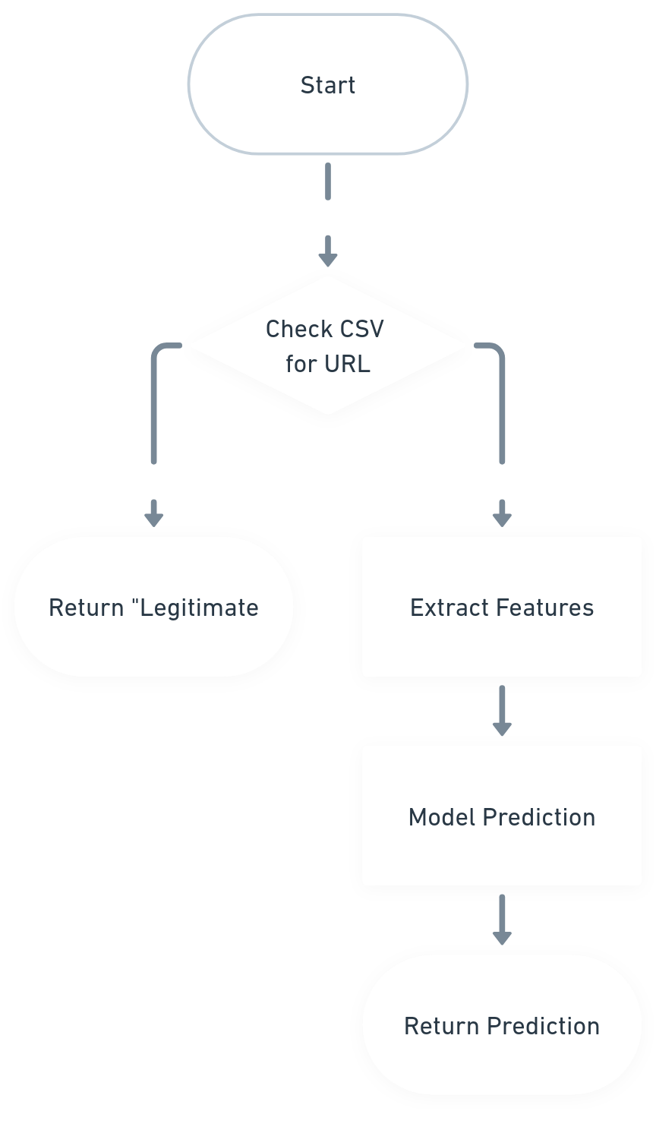
Flowchart on PhishAlert AI

Slide 16
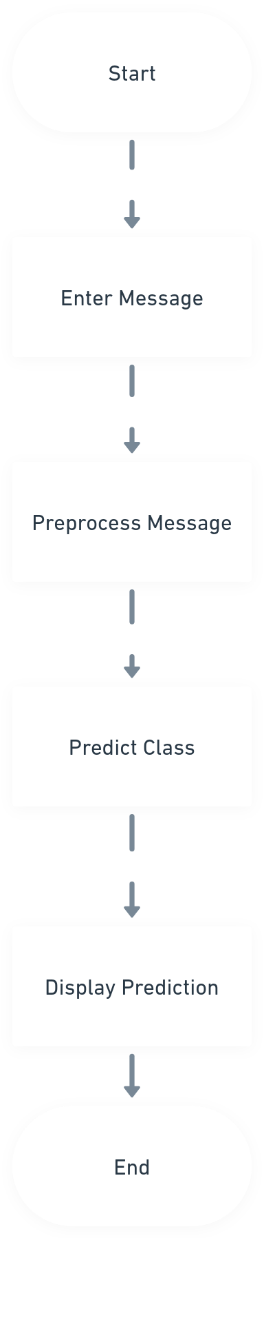
Flowchart on SMS/eMAIL detection

Slide 17
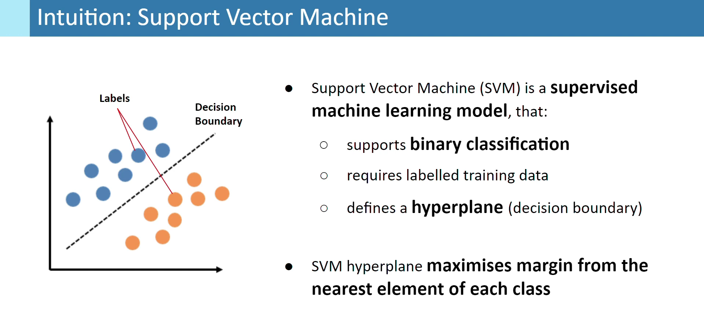

Slide 18
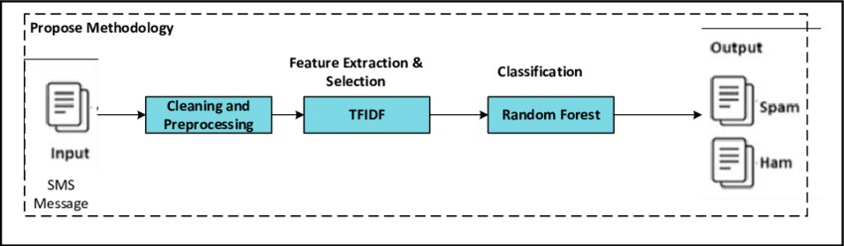
Machine learning algorithms operate on a numeric feature space, expecting input as a two-dimensional array where rows are instances and columns are features. To perform machine learning on text, we need to transform our documents into vector representations such that we can apply numeric machine learning. This process is called feature extraction or more simply, vectorization, and is an essential first step toward language-aware analysis.
The simplest encoding of semantic space is the bag-of-words model, whose primary insight is that meaning and similarity are encoded in vocabulary.
the vectorization process to combine linguistic techniques from NLTK with machine learning techniques in Scikit-Learn and Genism, creating custom transformers that can be used inside repeatable and reusable pipelines

Slide 19
Final Results
Successful development of a robust and efficient tool for detecting phishing domains.
Achieved high accuracy in distinguishing between phishing and legitimate domains.
Mitigated the risk of falling victim to phishing attacks.
Implemented real-time monitoring capabilities for timely threat alerts.
Enhanced cybersecurity measures for both users and organizations.

Slide 20
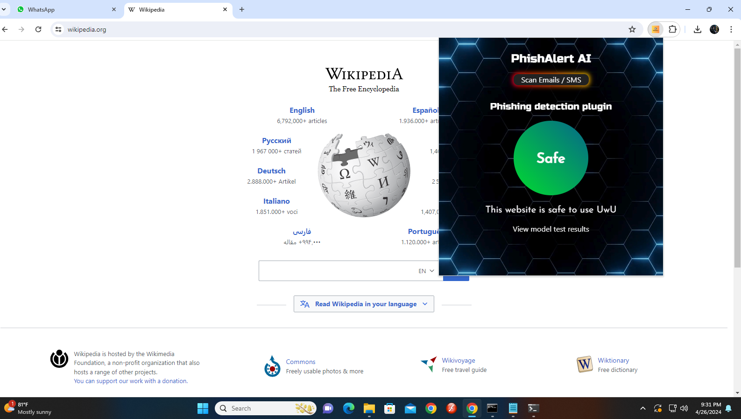

Slide 21
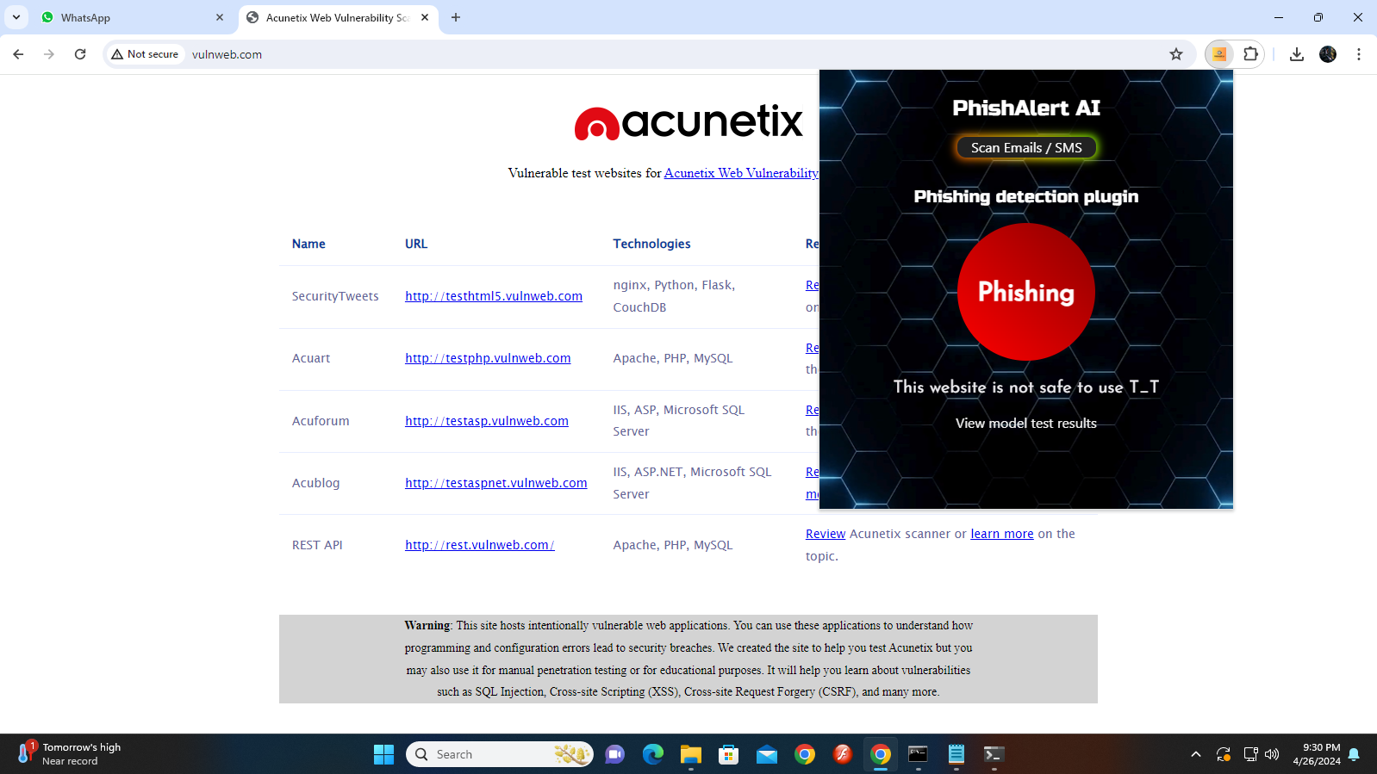

Slide 22
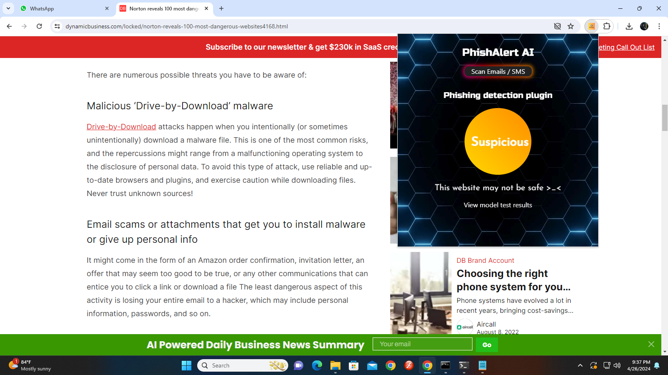

Slide 23
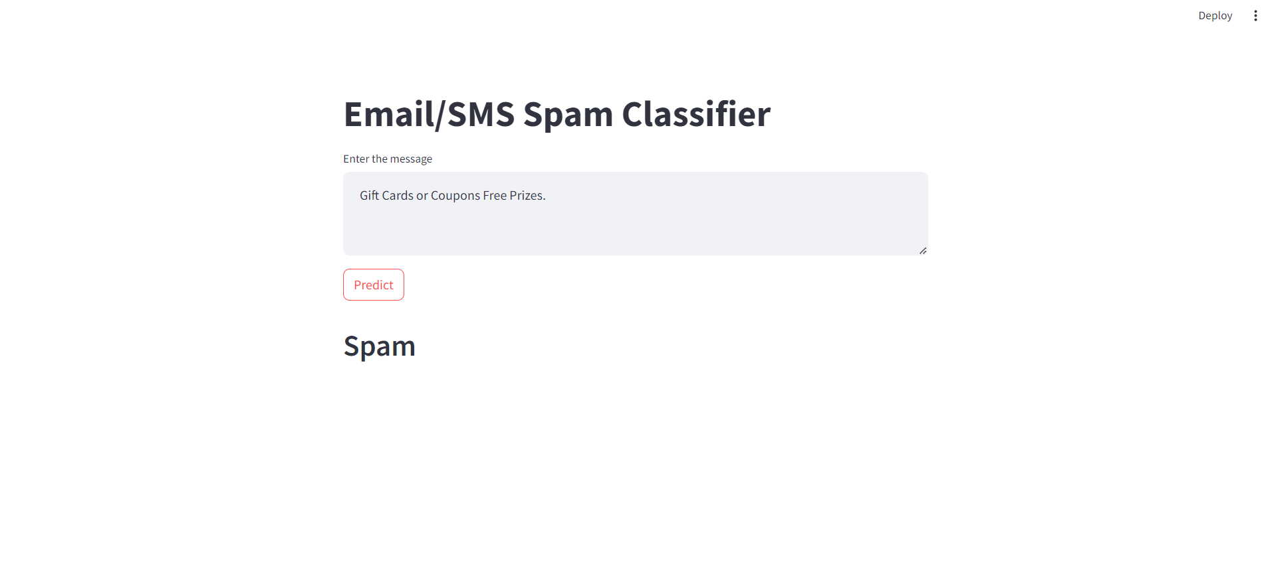

Slide 24
Thank You
Github link:- https://github.com/PHISHALERTAI/PHISHALERTAI.git

